Slide 1
Unit-6
String Matching and Introduction to NP-Completeness

Slide 2
Outline
  Introduction
  The Naive String Matching Algorithm
  The Rabin-Karp Algorithm
  The Knuth-Morris-Pratt Algorithm
  Boyer– Moore string-search algorithm,
  The class P and NP
  Polynomial reduction
  NP- Completeness Problem
  NP-Hard Problems
    Travelling Salesman problem
    Hamiltonian problem
Looping

Slide 3
Introduction
Text-editing programs frequently need to find all occurrences of a pattern in the text.
Efficient algorithms for this problem is called String-Matching Algorithms.
Among its many applications, “String-Matching” is highly used in Searching for patterns in DNA and Internet search engines.
Assume that the text is represented in the form of an array 𝑻[𝟏…𝒏] and the pattern is an array 𝑷[𝟏…𝒎].
Text T[1..13]
a
b
c
a
b
a
a
b
c
a
b
a
c
Pattern P[1..4]
a
b
a
a

Slide 4
Naive String Matching Algorithm

Slide 5
Naive String Matching - Example
The naive algorithm finds all valid shifts using a loop that checks the condition P[1..m] = T[s+1..s+m]
a
c
a
a
b
c
a
c
a
a
b
c
a
c
a
a
b
c
a
a
b
a
a
b
a
a
b
s = 0
s = 1
s = 2
a
c
a
a
b
c
Pattern matched with shift 2
P[1..m] = T[s+1..s+m]
a
a
b
s = 3

Slide 6
Naive String Matching - Algorithm
NAIVE-STRING MATCHER (T,P)
n = T.length
m = P.length
for s = 0 to n-m
if p[1..m] == T[s+1..s+m]
print “Pattern occurs with shift” s
T[1..6]
a
c
a
a
b
c
P[1..3]
a
a
a
a
a
b
a
a
b
b
a
b
2
s = 0
1
3
Pattern occurs with shift 2
Naive String Matcher takes time O((n-m+1)m)

Slide 7
Rabin-Karp Algorithm

Slide 8
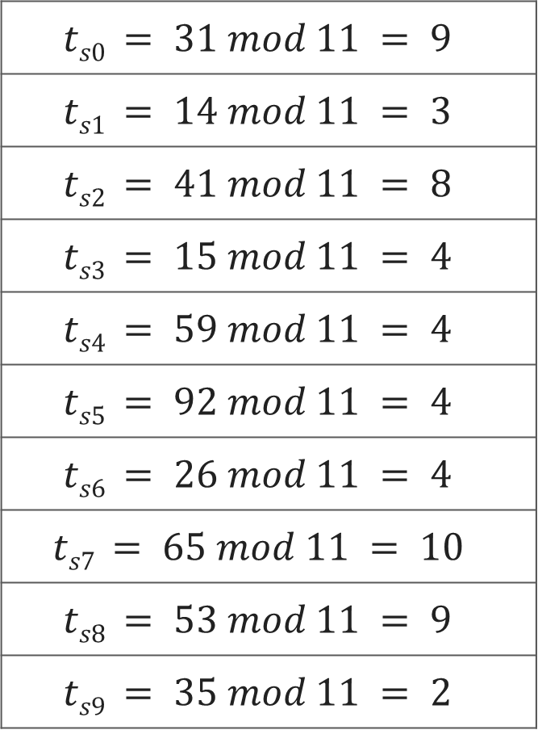
Text T
3 | 1 | 4 | 1 | 5 | 9 | 2 | 6 | 5 | 3 | 5
$$ts0 = 31 mod 11 = 9$$
$$ts1 = 14 mod 11 = 3$$
$$ts2 = 41 mod 11 = 8$$
$$ts3 = 15 mod 11 = 4$$
$$ts4 = 59 mod 11 = 4$$
$$ts5 = 92 mod 11 = 4$$
$$ts6 = 26 mod 11 = 4$$
$$ts7 = 65 mod 11 = 10$$
$$ts8 = 53 mod 11 = 9$$
$$ts9 = 35 mod 11 = 2$$
Pattern P
2 | 6
Choose a random prime number q = 11
Let, p = P mod q
= 26 mod 11 = 4
Let t_{s} denotes modulo q for text of length m
3 | 1 | 4 | 1 | 5 | 9 | 2 | 6 | 5 | 3 | 5
9 | 3 | 8 | 4 | 4 | 4 | 4 | 10 | 9 | 2

Slide 9
Pattern P
2 | 6
p = P mod q = 26 mod 11 = 4
2 | 6
Text T
3 | 1 | 4 | 1 | 5 | 9 | 2 | 6 | 5 | 3 | 5
t_{s}
9 | 3 | 8 | 4 | 4 | 4 | 4 | 10 | 9 | 2
Spurious Hit
Valid match
if t_{s} == p
if P[1..m] == T[s+1..s+m]
print “pattern occurs with shift” s

Slide 10

Rabin-Karp Algorithm
We can compute $t_{s}$ using following formula
t_{s+1} = 10(t_{s} - 10^{m-1}T[s+1]) + T[s + m + 1]
3 | 1 | 4 | 1 | 5 | 9 | 2 | 6 | 5 | 3 | 5
For m=2 and s=0 t_{s} = 31
We wish to remove higher order digit T[s+1]=3 and bring the new lower order digit T[s+m+1]=4
t_{s+1} = 10(31-10·3) + 4
= 10(1) + 4 = 14
t_{s+2} = 10(14-10·1) + 1
= 10(4) + 1 = 41

Slide 11
Rabin-Karp-Matcher
RABIN-KARP-MATCHER(T, P, d, q)
n ← length[T];
m ← length[P];
h ← d^{m-1} mod q;
p ← 0;
t₀ ← 0;
for i ← 1 to m do
p ← (d_{p} + P[i]) mod q
t₀ ← (dt₀ + T[i]) mod q
for s ← 0 to n – m do
if p == t_{s} then
if P[1..m] == T[s+1..s+m] then
print “pattern occurs with shift” s
if s < n-m then
t_{s+1} ← (d(t_{s} – T[s+1]h) + T[s+m+1]) mod q
T | 3 | 1 | 4 | 1 | 5 | 9 | 2 | 6 | 5 | 3 | 5
P | 2 | 6
d | 10
q | 11
n | 11
m | 2
h | 10
t₀ | 9
p | 4
t₀ | 0
p | 0

Slide 12
String Matching with Knuth-Morris-Pratt Algorithm

Slide 13
Introduction
The KMP algorithm relies on prefix function (π).
Proper prefix: All the characters in a string, with one or more cut off the end. “S”, “Sn”, “Sna”, and “Snap” are all the proper prefixes of “Snape”.
Proper suffix: All the characters in a string, with one or more cut off the beginning. “agrid”, “grid”, “rid”, “id”, and “d” are all proper suffixes of “Hagrid”.
KMP algorithm works as follows:
  Step-1: Calculate Prefix Function
  Step-2: Match Pattern with Text

Slide 14
Longest Common Prefix and Suffix
 | 1 | 2 | 3 | 4 | 5 | 6 | 7
Pattern | a | b | a | b | a | c | a
Prefix(π) | 0 | 0 | 1 | 2 | 3 | 0 | 1
ababa
abab
aba
ab
a
We have no possible prefixes
Possible prefix = a
Possible prefix = a, ab, aba, abab
Possible prefix = a, ab
Possible prefix = a, ab, aba
We have no possible suffixes
Possible suffix = b
Possible suffix = a, ba, aba, baba
Possible suffix = a, ba
Possible suffix = b, ab, bab

Slide 15
Calculate Prefix Function - Example
k+1
q
q
k+1
 | 1 | 2 | 3 | 4 | 5 | 6 | 7
P | a | c | a | c | a | g | t
π | 0 | 0 | 1 | 2 | 3 | 0 | 0
false
P[k+1]==P[q]
true
k =
0
1
2
3
1
0
q =
2
3
4
5
6
7
false
k>0
true
Initially set π[1] = 0
k is the longest prefix found
q is the current index of pattern
k=π[k]
k=k+1
π[q]=k

Slide 16
KMP- Compute Prefix Function
COMPUTE-PREFIX-FUNCTION(P)
  m ← length[P]
  π[1] ← 0
  k ← 0
  for q ← 2 to m
  while k > 0 and P[k + 1] ≠ P[q]
  k ← π[k]
  end while
  if P[k + 1] == P[q] then
  k ← k + 1
  end if
  π[q] ← k
  return π

Slide 17
KMP String Matching
 | 1 | 2 | 3 | 4 | 5 | 6 | 7
Pattern | a | c | a | c | a | g | t
Prefix(π) | 0 | 0 | 1 | 2 | 3 | 0 | 0
T | a | c | a | t | a | c | g | a | c | a | c | a | g | t
Mismatch ?
Check value in prefix table
a
c
a
c
a
g
t
a
c
a
c
a
g
t
We can skip 2 shifts
(Skip unnecessary shifts)
T | a | c | a | t | a | c | g | a | c | a | c | a | g | t
a
c
a
c
a
g
t
Mismatch ?
Check value in prefix table
T | a | c | a | t | a | c | g | a | c | a | c | a | g | t
a
c
a
c
a
g
t
Mismatch ?
Check value in prefix table

Slide 18
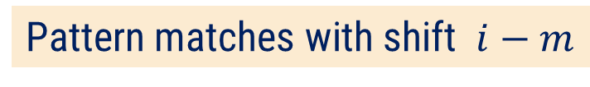
KMP String Matching
 | 1 | 2 | 3 | 4 | 5 | 6 | 7
Pattern | a | c | a | c | a | g | t
Prefix(π) | 0 | 0 | 1 | 2 | 3 | 0 | 0
T | a | c | a | t | a | c | g | a | c | a | c | a | g | t
Mismatch ?
Check value in prefix table
a
c
a
c
a
g
t
We can skip 2 shifts
(Skip unnecessary shifts)
T | a | c | a | t | a | c | g | a | c | a | c | a | g | t
a
c
a
c
a
g
t
T | a | c | a | t | a | c | g | a | c | a | c | a | g | t
a
c
a
c
a
g
t
Pattern matches with shift $i−m$

Slide 19
KMP-MATCHER
KMP-MATCHER(T, P)
n ← length[T]
m ← length[P]
π ← COMPUTE-PREFIX-FUNCTION(P)
q ← 0 //Number of characters matched.
for i ← 1 to n //Scan the text from left to right.
while q > 0 and P[q + 1] ≠ T[i]
q ← π[q] //Next character does not match.
if P[q + 1] == T[i] then
then q ← q + 1 //Next character matches.
if q == m then //Is all of P matched?
print "Pattern occurs with shift" i - m
q ← π[q] //Look for the next match.

Slide 20
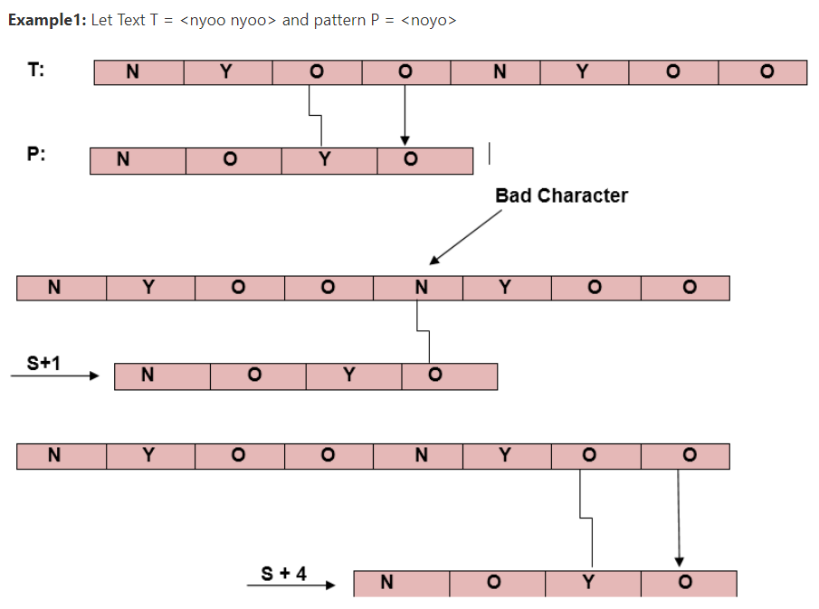
Boyer– Moore string-search algorithm
Boyer Moore is a combination of the following two approaches.
Bad Character Heuristic
Good Suffix Heuristic

Slide 21
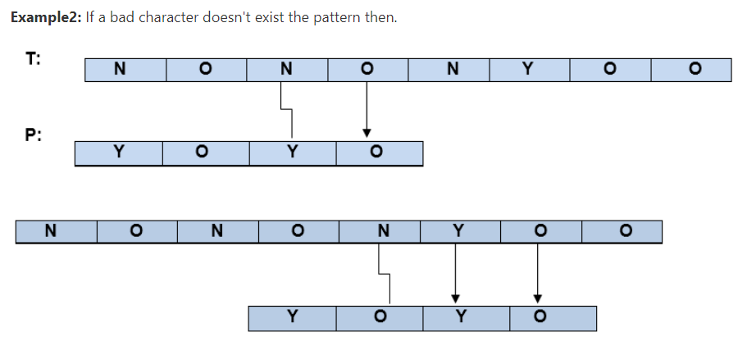

Slide 22
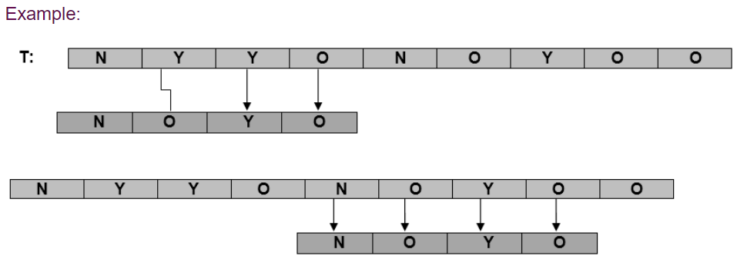
Good Suffix Heuristics:

Slide 23
The class P and NP

Slide 24
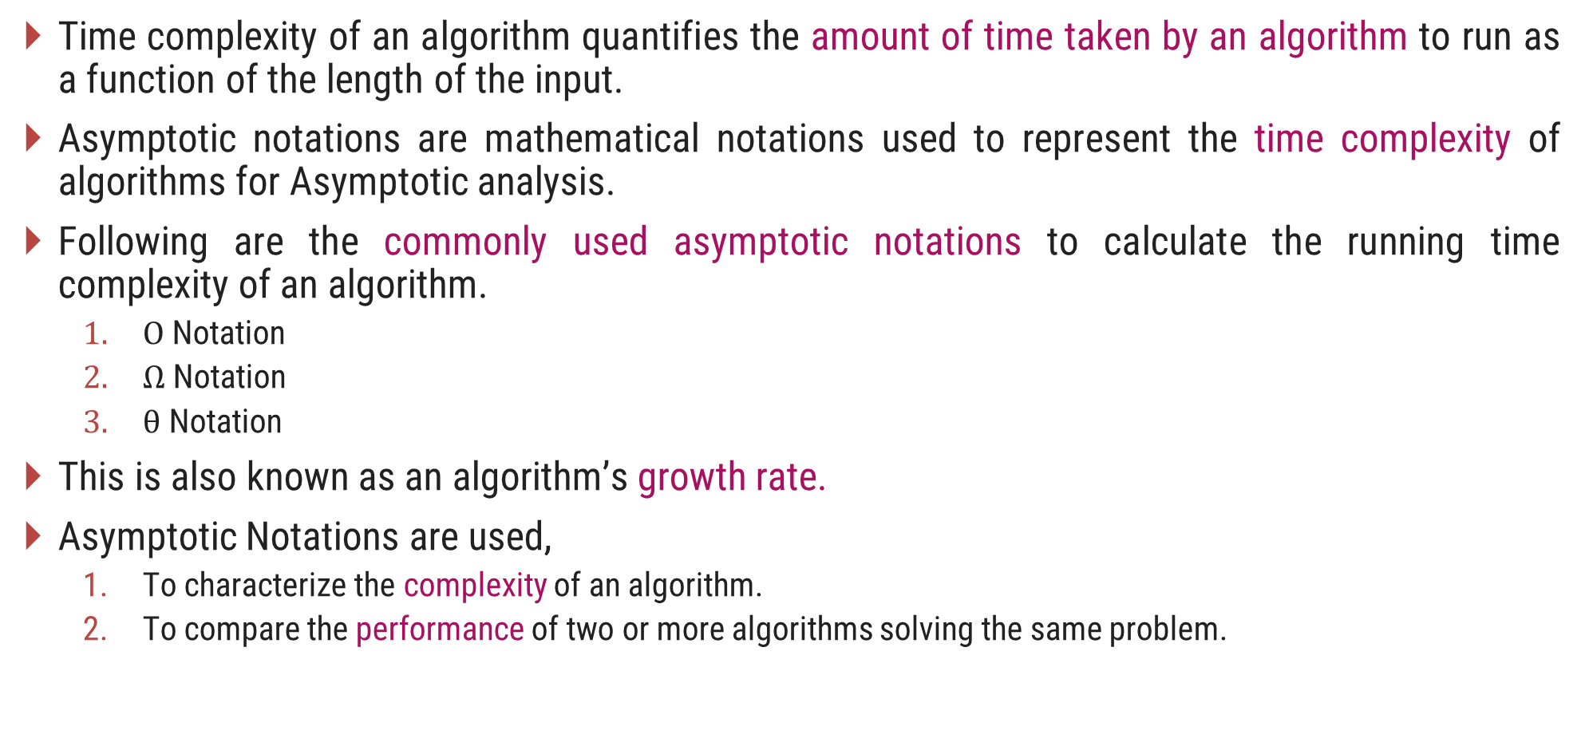
Time Complexity of an Algorithm
Time complexity of an algorithm quantifies the amount of time taken by an algorithm to run as a function of the length of the input.
Asymptotic notations are mathematical notations used to represent the time complexity of algorithms for Asymptotic analysis.
Following are the commonly used asymptotic notations to calculate the running time complexity of an algorithm.
  $Ο$ Notation
  $Ω$ Notation
  $θ$ Notation
This is also known as an algorithm’s growth rate.
Asymptotic Notations are used,
  To characterize the complexity of an algorithm.
  To compare the performance of two or more algorithms solving the same problem.

Slide 25
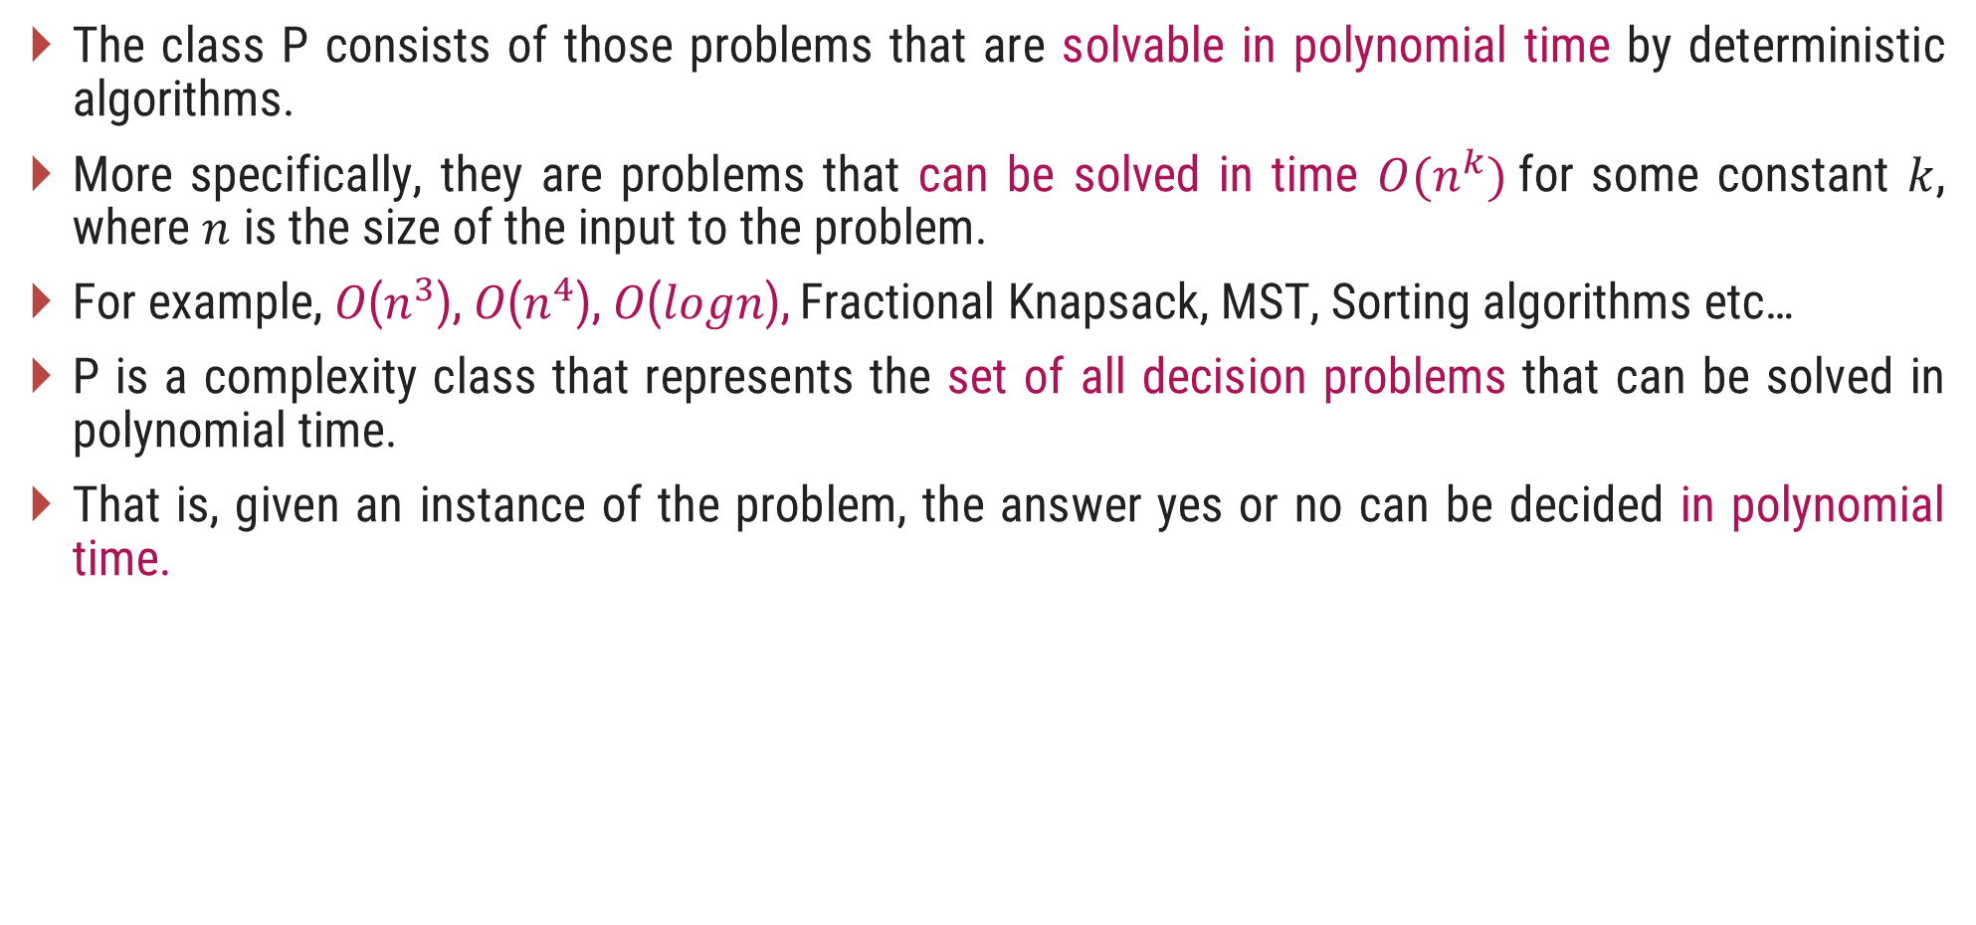
The Class P
The class P consists of those problems that are solvable in polynomial time by deterministic algorithms.
More specifically, they are problems that can be solved in time $O(n^{k})$for some constant $k$, where $n$ is the size of the input to the problem.
For example, 𝑂($n^{3}$), 𝑂($n^{4}$), 𝑂(𝑙𝑜𝑔𝑛), Fractional Knapsack, MST, Sorting algorithms etc…
P is a complexity class that represents the set of all decision problems that can be solved in polynomial time.
That is, given an instance of the problem, the answer yes or no can be decided in polynomial time.

Slide 26
The NP class
NP is Non-Deterministic polynomial time.
The class NP consists of those problems that are verifiable in polynomial time.
NP is the class of decision problems for which it is easy to check the correctness of a claimed answer, with the help of a little extra information.
Hence, we are not asking for a way to find a solution, but only to verify that an alleged solution really is correct.
Every problem in this class can be solved in exponential time using exhaustive search.

Slide 27
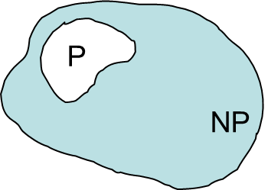

P and NP Class Problems
P = set of problems that can be solved in polynomial time
NP = set of problems for which a solution can be verified in polynomial time
$P  NP$

Slide 28
Classification of NP Problems
NP Complete
NP-complete problems are a set of problems to each of which any other NP-problem can be reduced in polynomial time, and whose solution may still be verified in polynomial time.
No polynomial-time algorithm has been discovered for an NP-Complete problem.
NP-Complete is a complexity class which represents the set of all problems X in NP for which it is possible to reduce any other NP problem Y to X in polynomial time.
NP Hard
NP-hard problems are those at least as hard as NP problems, i.e., all NP problems can be reduced (in polynomial time) to them.
NP-hard problems need not be in NP, i.e., they need not have solutions verifiable in polynomial time.
The precise definition here is that a problem X is NP-hard, if there is an NP-complete problem Y, such that Y is reducible to X in polynomial time.

Slide 29
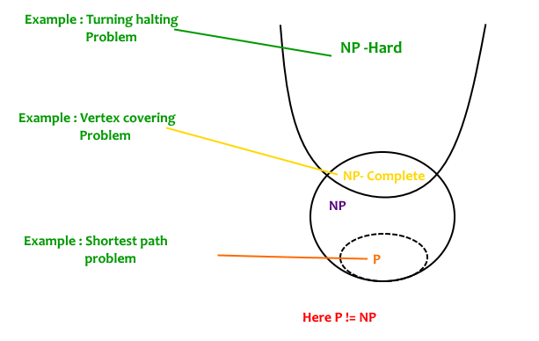
P, NP Complete and NP Hard

Slide 30
Polynomial Reduction

Slide 31
Introduction
Let us consider a decision problem A, which we would like to solve in polynomial time.
Now suppose, we already know how to solve a different decision problem B in polynomial time.
Finally we have a procedure that transforms any instance α of A into some instance β of B with the following characteristics.
  The transformation takes polynomial time.
  The answers are same. That is the answer for α is “yes” if and only if the answer of β is also “yes”.
We call such a procedure a polynomial-time reduction algorithm and it provides us a way to solve problem A in polynomial time:

Slide 32
Polynomial Reduction
Given an instance α of problem A, use a polynomial-time reduction algorithm to transform it to an instance β of problem B.
Run the polynomial-time decision algorithm for B on the instance β.
Use the answer for β as the answer for α.
In other words, by "reducing" solving problem A to solving problem B, we use the "easiness" of B to prove the "easiness" of A.
Yes
α
Polynomial time Reduction Algorithm
β
Polynomial time Algorithm to decide B
No
Polynomial time Algorithm to decide A

Slide 33
NP Hard Problems

Slide 34
Hamiltonian Cycles
Hamiltonian Path in an undirected graph is a path that visits each vertex exactly once.
A Hamiltonian cycle (or Hamiltonian circuit) is a Hamiltonian Path such that there is an edge (in the graph) from the last vertex to the first vertex of the Hamiltonian Path.
Given a list of vertices and to check whether it forms a Hamiltonian cycle or not:
Counts the vertices to make sure they are all there, then checks that each is connected to the next by an edge, and that the last is connected to the first.
1
2
3
4
The graph has Hamiltonian cycles:
1, 3, 4, 5, 6, 7, 8, 2, 1 and 1, 2, 8, 7, 6, 5, 4, 3, 1.
8
7
6
5

Slide 35
Hamiltonian Cycles
It takes time proportional to 𝑛, because there are 𝑛 vertices to count and 𝑛 edges to check. 𝑛 is a polynomial, so the check runs in polynomial time.
To find a Hamiltonian cycle from the given graph: There are 𝑛! different sequences of vertices that might be Hamiltonian paths in a given 𝑛-vertex graph, so a brute force search algorithm that tests all possible sequences can not be solved in polynomial time.
In the traveling salesman Problem, a salesman must visits n cities.
We can say that salesman wishes to make a tour or Hamiltonian cycle, visiting each city exactly once and finishing at the city he starts from.

Slide 36
Traveling Salesman Problem
In TSP, we find a tour and check that the tour contains each vertex once. Then the total cost of the edges of the tour is calculated.
How would you verify that the solution you're given really is the shortest loop? In other words, how do you know there's not another loop that's shorter than the one given to you?
The only known way to verify that a provided solution is the shortest possible solution is to actually solve TSP.
Since it takes exponential time to solve NP, the solution cannot be checked in polynomial time. Thus this problem is NP-hard, but not in NP.

Slide 37
Thank You

